Slide 1
Discrete Probability Distributions
Chapter 6
Notes:
This chapter begins the study of probability distributions. We first discuss the mean, variance, and standard deviation of a probability distribution. Then we discuss three frequently occurring probability distributions: the binomial, hypergeometric, and Poisson.

Slide 2
Learning Objectives
LO6-1 Identify the characteristics of a probability distribution
LO6-2 Distinguish between discrete and continuous random variables
LO6-3 Compute the mean, variance, and standard deviation of a discrete probability distribution
LO6-4 Explain the assumptions of the binomial distribution and apply it to calculate probabilities
LO6-5 Explain the assumptions of the hypergeometric distribution and apply it to calculate probabilities

Slide 3
What is a Probability Distribution?
For example, a drug manufacturer may claim a treatment will cause weight loss for 80 percent of the population. A consumer protection agency may test the treatment on a sample of six people. If the manufacturer’s claim is true, it is almost impossible to have an outcome where no one in the sample loses weight and it is most likely that five out of the six do lose weight.
PROBABILITY DISTRIBUTION A listing of all the outcomes of an experiment and the probability associated with each outcome.
CHARACTERISTICS OF A PROBABILITY DISTRIBUTION
The probability of a particular outcome is between 0 and 1 inclusive.
The outcomes are mutually exclusive.
The list of outcomes is exhaustive. So the sum of the probabilities of the outcomes is equal to 1.
Notes:
A probability distribution gives the entire range of values that can occur based on an experiment.

Slide 4
This chapter will begin the study of probability distributions.
A probability distribution gives the entire range of values that can occur based on an experiment.
A probability distribution is similar to a relative frequency distribution. But instead of describing past, it describes a likely future event.
In this chapter, we discuss the mean, variance, and standard deviation of a probability distribution.
We also discuss three frequently occurring probability distributions:
Binomial, Hypergeometric, and Poisson distributions.

Slide 5
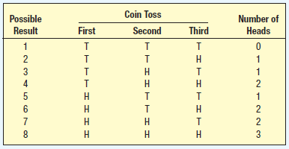
Probability Distribution Example
Suppose we are interested in the number of heads showing face up with 3 tosses of a coin
The possible outcomes are 0 heads, 1 head, 2 heads, and 3 heads
What is the probability distribution for the number of heads?
Notes:
Using the counting formula from chapter 5 we note there are 8 possible outcomes when tossing a coin three times since you will observe either a head or a tail, two possibilites, and this toss is repeated 3 times so (2)(2)(2) = 8. Using this data we can construct a probability distribution.

Slide 6
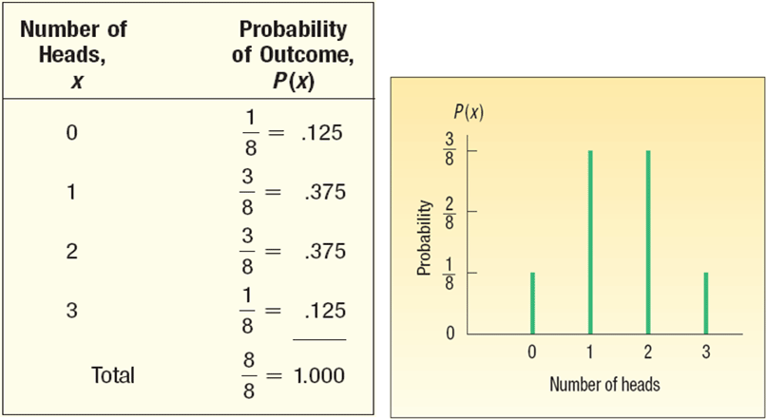
Probability Distribution Table
Discrete probability distribution table and chart for the events of zero, one, two, and three heads
Notes:
Tossing the coin three times results in 8 different outcomes. The events of 0 heads, 1, 2, or 3 heads are mutually exclusive and exhaustive so the sum of the probabilities is 1.000.

Slide 7
Random Variables
In any experiment of chance, the outcomes occur randomly, and so are called random variables
Some experiments result in outcomes that are quantitative (such as dollars, weight, or number of children)
Others result in qualitative outcomes (such as color or religious preference). Each value of the random variable is associated with a probability to indicate the chance of a particular outcome.
Examples
The number of employees absent on Monday, the number might be 0, 1, 2, 3, …The number absent is the random variable.
The grade level (Freshman, Sophomore, Junior, or Senior) of the members of basketball team. The grade level is a random variable
RANDOM VARIABLE A quantity resulting from an experiment that, by chance, can assume different values.
Notes:
In any experiment of chance, the outcomes occur randomly. So the outcome is called a random variable. Random variables can be measured with quantitative variables or qualitative variables.

Slide 9
How do you tell the difference between the two types of distributions?
Usually a discrete distribution is the result of counting something , such as
• The number of heads appearing when a coin is tossed 3 times.
• The number of students earning an A in this class.
• The number of production employees absent from the second shift today.
• The number of 30-second commercials on NBC from 8 to 11 P.M. tonight.
Continuous distributions are usually the result of some type of measurement, such as:
• The weight of each student in this class
• The temperature outside as you are reading this book.
• The amount of money earned by each of the more than 750 players currently on Major Baskteball.

Slide 10
Two Types of Random Variables
One type of random variable is the discrete random variable
Discrete variables are usually the result of counting
Examples
Tossing a coin three times and counting the number of heads
A bank counting the number of credit cards carried by a group of customers
DISCRETE RANDOM VARIABLE A random variable that can assume only certain clearly separated values.
Notes:
Note: a discrete random variable can assume fractional or decimal values but the values must be separated by having distance between each value.

Slide 11
Discrete Random Variable
For example, the Bank of the Carolinas counts the number of credit cards carried by a group of customers
The number of cards carried is the discrete random variable
Number of Credit Cards | Relative Frequency
0 |  | .03
1 |  | .10
2 |  | .18
3 |  | .21
4 or more |  | .48
Total |  | 1.00
Notes:
The results of this survey were obtained by counting the number of credit cards carried by a group of customers and are summarized in the table using relative frequencies.

Slide 12
Continuous Random Variables
Continuous random variables can assume an infinite number of values within a given range
Continuous variables are usually the result of measuring
Examples
The time between departure flights from KAIA are 0.23 minutes, 0.30 m, 15.8 m, and so on
Tire pressure, measured in (psi), for a car might be 32.78 psi, 31.62 psi, 33.07 psi, and so on. In other words, any values between 28 and 35 could reasonably occur. The random variable is the tire pressure.
Notes:
Continuous random variables are measured with interval or ratio scale and the likelihood of a continuous random variable can be summarized with a probability distribution. This will be covered in the next chapter.

Slide 13
Mean and Variance of a Discrete Probability Distribution
The mean is a typical value used to represent the central location of the probability dist. (data)
The mean is also referred to as the expected value
The amount of spread (or variation) in the data is described by the variance
The standard deviation of the probability distribution is the positive square root of the variance
Notes:
The mean of a probability distribution is the long run average of the random variable. P(x) represents the probability of a particular value of x. To calculate the mean, multiply each value of x by its probability of occurrence and then add these products.

Slide 14
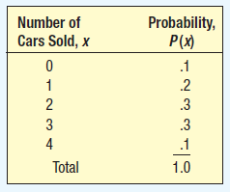
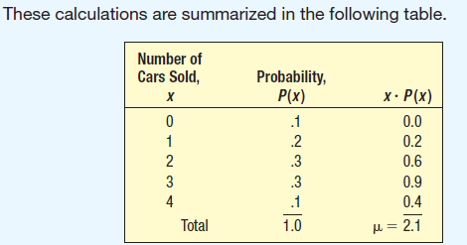
Probability Distribution Mean Example
John Ragsdale sells new cars for Pelican Ford. John usually sells the most cars on Saturday. He has developed a probability distribution for the number of cars he expects to sell on Saturday.
What type of distribution is this?
How many cars does John expect to sell on a typical Saturday?
What is the variance?
Notes:
This is a discrete probability distribution. We find John can expect to sell 2.1 cars on a typical Saturday. In other words, over the long run, say 50 Saturdays in a year, he can expect to sell (50)(2.1) = 105 cars. The variance is calculated on the next slide.

Slide 15
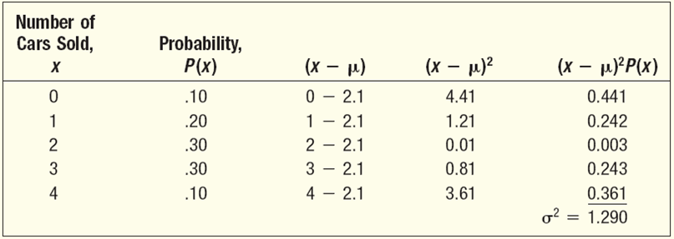
Probability Distribution Variance Example
The computational steps for variance
Subtract the mean from each value of x and square
Multiply each squared difference by its probability
Sum the resulting products to arrive at the variance
Notes:
Take the (positive) square root of the variance to get the standard deviation. The mean is 2.1, the variance is 1.290, and the standard deviation is 1.136 cars.

Slide 16
Probability Distribution Variance Example
Shortcut Formula
Notes:
Take the (positive) square root of the variance to get the standard deviation. The mean is 2.1, the variance is 1.290, and the standard deviation is 1.136 cars.

Slide 17
Binomial Distribution
There are four requirements of a binomial probability distribution
  There are only two possible outcomes and the outcomes are mutually exclusive, as either a success or a failure
  The number of trials is fixed and known
  The probability of a success is the same for each trial
  Each trial is independent of any other trial
Example
A young family has two children, both boys. The probability of the third birth being a boy is still .50. The gender of the third child is independent of the gender of the other two.
Notes:
The binomial distribution is a widely occurring discrete probability distribution.

Slide 18

Binomial Probability Experiment
Use the number of trials, n, and the probability of a success, $\text{π},$ to compute binomial probability
Note: Do not confuse the symbol $\text{π},$ with the mathematical constant 3.1416
BINOMIAL PROBABILITY EXPERIMENT
An outcome on each trial of an experiment is classified into one of two mutually exclusive categories — a success or a failure.
The random variable is the number of successes in a fixed number of trials.
The probability of success is the same for each trial.
The trials are independent, meaning that the outcome of one trial does not affect the outcome of any other trial.
Notes:
The Greek letter $\text{π}$, (pi) is used to denote a binomial population parameter. The formula to compute binomial probability is found on the next slide.

Slide 19
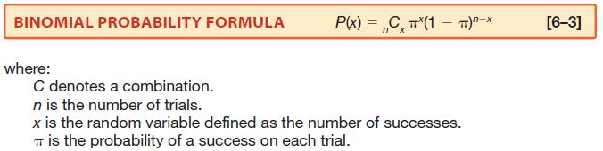
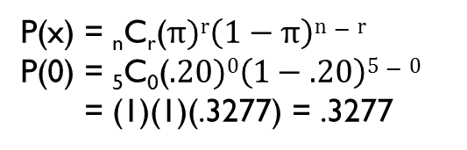
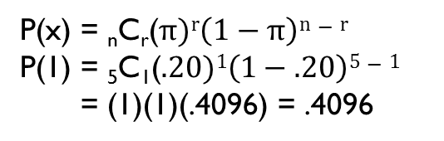
How is a Binomial Probability Computed?
There are five flights daily from Pittsburgh. Suppose the probability that any flight arrives late is .20.
What is the probability that none of the flights are late today?
P(x) = _{n}C_{r}($π)r\left(1−π\right)n−r$
P(0) = ₅C₀($.20)0\left(1−.20\right)5−0$
= (1)(1)(.3277) = .3277
What is the probability that exactly one of the flights is late today?
P(x) = _{n}C_{r}($π)r\left(1−π\right)n−r$
P(1) = ₅C₁($.20)1\left(1−.20\right)5−1$
= (1)(1)(.4096) = .4096
Notes:
C represents a combination; you may recall we calculated combinations in chapter 5. In this example, just insert the value for x that you wish to find, the value 5 for n and .20 for $π$, and solve. With an n = 5, we can find the probabilities for 6 different x outcomes: 0, 1, 2, 3, 4, and 5 late flights. See the table on the next page.

Slide 20
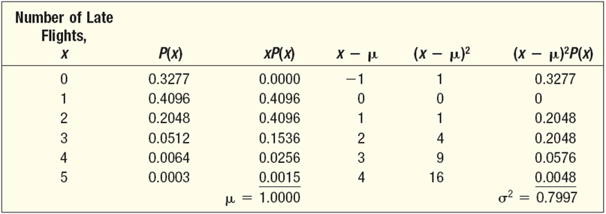
Binomial Probability Distribution
There are five flights daily from Pittsburgh. Suppose the probability that any flight arrives late is .20. What is the probability that none of the flights are late today? What is the probability that exactly 1 of the flights is late today?
Notes:
Use formula 6-3 to complete the table by finding the P(x) for the number of successes from 0 to 5. Then multiply each value of x by its probability and sum the products. The result will be the mean. Next, find the differences of each value of x and the mean and then square these differences. Multiply this squared value by the respective probability and sum the products, the result is the variance.

Slide 21
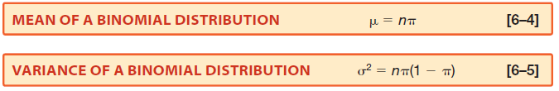
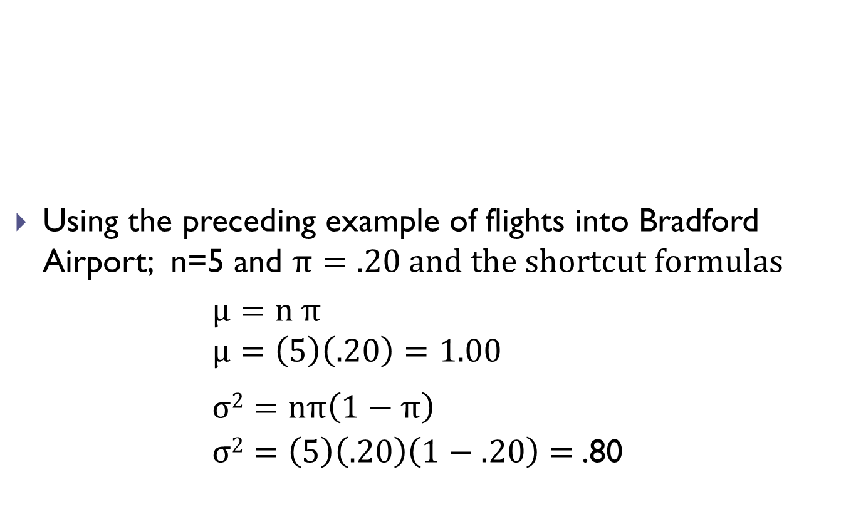
Shortcut Formulas
Using the preceding example of flights into Bradford Airport; n=5 and $π=.20 and the shortcut formulas$
                $$μ=n π$$
                $$μ=\left(5\right)\left(.20\right)=1.00$$
                $$σ2=nπ\left(1−π\right)$$
                $σ2=\left(5\right)\left(.20\right)\left(1−.20\right)=$.80
Notes:
Here is a shortcut method of finding the mean and variance of a binomial distribution. Verify these results with the table on the preceding slide.

Slide 22
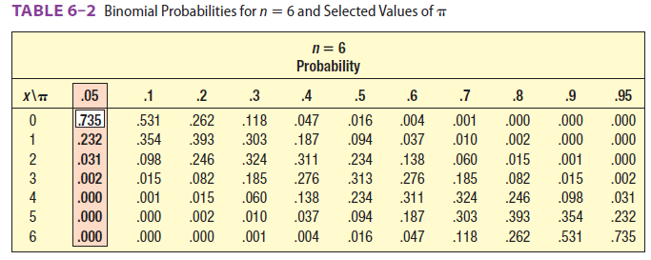
Binomial Probability Tables
Tables are already constructed for use as well
In the Southwest, 5% of all cell phone calls are dropped. What is the probability that out of six randomly selected calls, none was dropped? Exactly one? Exactly two? Exactly three? Exactly four? Exactly five? Exactly six out of six? See the table below for the answers.
Notes:
In this example, the conditions for a binomial distribution are met. You can build a binomial probability distribution using Formula 6-3 for any value of n and $π$. However, the calculations take time. For convenience, tables like the one here are provided in Appendix B.1 for various values of n and $π$.
Excel can be used to find binomials as well.

Slide 23
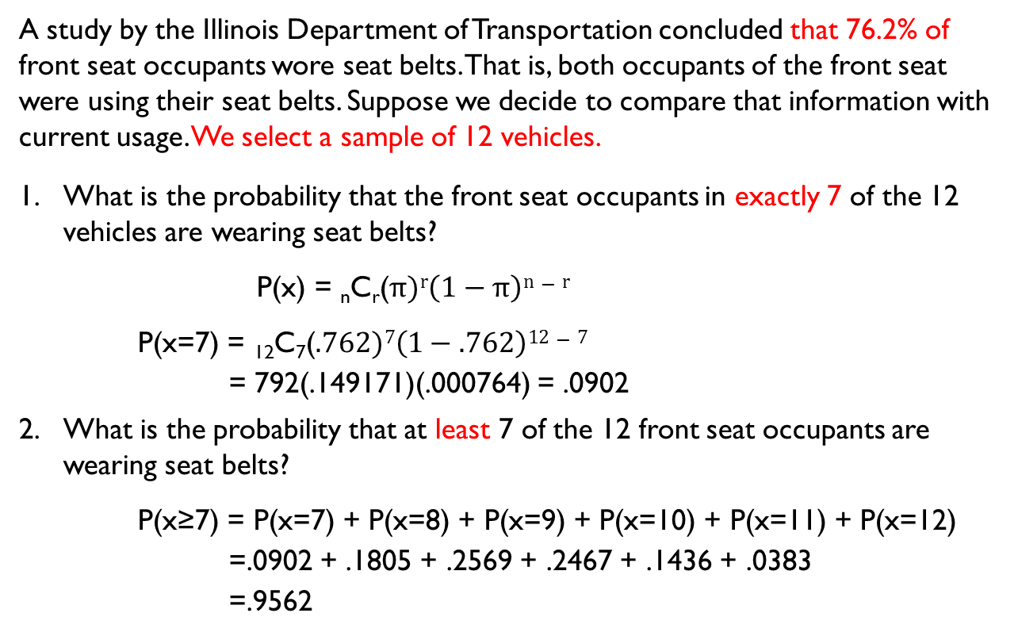
Cumulative Binomial Probability Distributions
A study by the Illinois Department of Transportation concluded that 76.2% of front seat occupants wore seat belts. That is, both occupants of the front seat were using their seat belts. Suppose we decide to compare that information with current usage. We select a sample of 12 vehicles.
What is the probability that the front seat occupants in exactly 7 of the 12 vehicles are wearing seat belts?
P(x) = _{n}C_{r}($π)r\left(1−π\right)n−r$
P(x=7) = ₁₂C₇($.762)7\left(1−.762\right)12−7$
= 792(.149171)(.000764) = .0902
What is the probability that at least 7 of the 12 front seat occupants are wearing seat belts?
P(x≥7) = P(x=7) + P(x=8) + P(x=9) + P(x=10) + P(x=11) + P(x=12)
=.0902 + .1805 + .2569 + .2467 + .1436 + .0383
=.9562
Notes:
We conclude the likelihood that the occupants of exactly 7 out of 12 sampled vehicles will be wearing their seat belts is about 9%. And the probability of selecting 12 cars and finding that the occupants of 7 or more vehicles were wearing seat belts is .9562. The Excel commands for these calculations are found in Appendix C.

Slide 24
Hypergeometric Distribution
When sampling from relatively small populations without replacement, use the hypergeometric distribution
HYPERGEOMETRIC PROBABILITY EXPERIMENT
An outcome on each trial of an experiment is classified into one of two mutually exclusive categories — a success or a failure.
The random variable is the number of successes in a fixed number of trials.
The trials are not independent.
We assume that we sample from a finite population without replacement and n/N > 0.05. So, the probability of a success changes for each trial.
Notes:
Here is a list of the characteristics of the Hypergeometric Distribution.

Slide 26

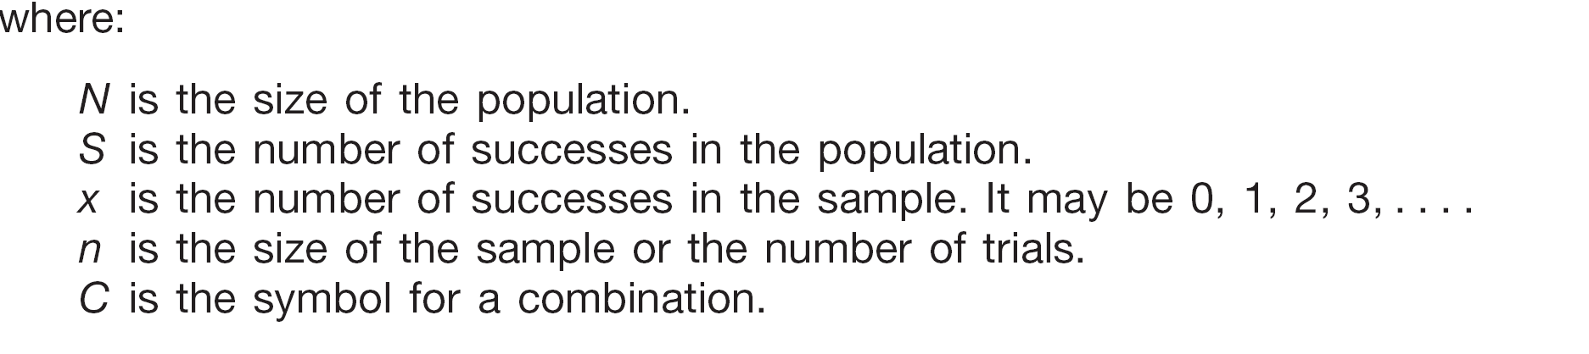
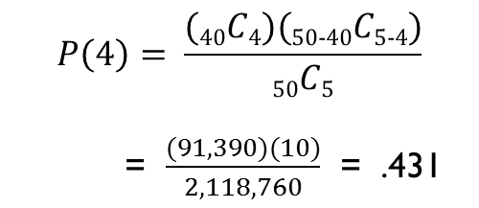
Hypergeometric Formula
PlayTime Toys Inc. employs 50 people in the Assembly Dept. Forty of the employees belong to a union and 10 do not. Five employees are selected at random to form a committee. What is the probability that four of the five belong to a union.
$$P\left(4\right)= \frac{(40C4)(50\text{−}40C5\text{−}4)}{50C5}$$
= $\frac{(91,390)(10)}{2,118,760}$ = .431
Notes:
Insert the following values in the formula and solve. N=50, S=40, x is 4, n is 5. Thus, the probability of selecting 5 assembly workers at random from the 50 workers and finding 4 of the 5 are union members is .431.

Slide 27
Hypergeometric Probabilities
Union Members | Probability
0 |  | .000
1 |  | .004
2 |  | .044
3 |  | .210
4 |  | .431
5 |  | .311
 |  | 1.000
Notes:
Table 6-4 Hypergeometric Probabilities (n=5, N=50, and S=40) for the Number of Union members on the Committee. This table shows the hypergeometric probabilities of finding 0, 1, 2, 3, 4, and 5 union members on the committee. Excel can be used to create a hypergeometric distribution too; the steps to do so can be found in Appendix C.

